Slide 1
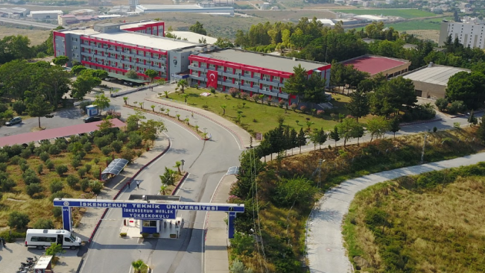
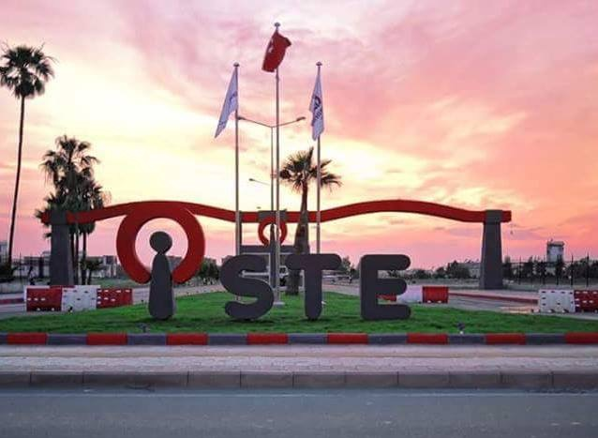
Who is an environmental technician?
ISTE Integration with Business World (IDE)
The IDE program, which was initiated in order to transform our students who graduated from the ISTE Environmental Protection and Control program into successful personnel in the business world, turned into an application that attracted great attention by business people in a short time.
SKENDERUN VOCATIONAL SCHOOL
Laboratory Facilities
Chemistry Laboratory where water analysis is conducted
Computer Laboratory where computer design courses are conducted
What are the departments that can be settled with DGS?
İskenderun Teknik Üniversitesi İskenderun Meslek Yüksekokulu Tepe Kampüsü 31200 İskenderun, HATAY
Tel: +90 326 613 56 00
Fax: +90 326 618 29 30
www.iste.edu.tr/imyo-çkk
ENVIRONMENTAL PROTECTION TECHNOLOGIES DEPARTMENT
ENVIRONMENTAL PROTECTION AND CONTROL PROGRAM
Those who successfully completed the program, if they are successful in the Vertical Transfer Exam held by ÖSYMThey will be able to make vertical transfer to
Environmental Engineering,
Biology,
Chemistry,
Health Management and
Social Work Departments.
.
It is the person who is aware of the environmental problems and works on the establishment and operation of the facilities necessary for the destruction of the wastes that cause air, water and soil pollution without damaging the environment and inspects the facilities.

Slide 2
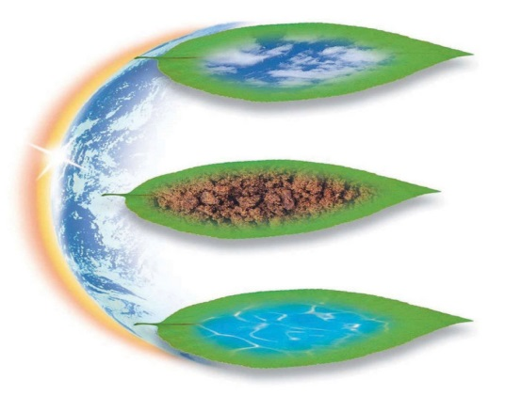
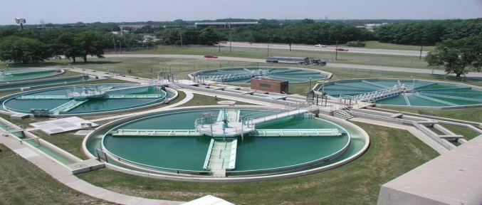
Being an Environmental Technician in Turkey
Due to the fact that environmental awareness is not sufficiently developed in our country, the number of people working in the environmental field is very low. This situation results in the fact that our graduates have high job opportunities. Our graduates can work in business, laboratory and inspection units.
I n addition, the work opportunities of environmental technicians are increasing with the implementation and implementation of legal regulations aiming to impose the obligation of employing environmental technicians for institutions and organizations that are likely to pollute the environment due to their production method.
Environmental Technician is among the favorite professions of the future in our country, whose environmental problems are increasing day by day.
What are the Working Areas of Environmental Technicians?
Ministry of Environment and Urbanization central, provincial and provincial organizations;
All domestic and / or industrial wastewater treatment facilities;
All drinking water treatment facilities
Metropolitan, provincial or district municipalities;
Environmental protection and control departments,
Drinking water department,
Wastewater channel administrations,
Solid waste control branches,
Air quality control units,
OIZ Directores,
Public / Private Environmental Analysis Laboratories;
Emission (Flue Gas) Measurements,
Imission (Air Quality) Measurements
Environmental Noise Measurements
D. Environmental Vibration Measurements
to. Drinking and Potable Water Analysis
Wastewater Analysis
Sea Water Analysis
Waste / Solid Waste / Treatment Sludge / Soil
Waste Oil Analysis
In the private sector;
In all businesses with an Environmental Management Unit,
Companies that establish and operate small or large scale wastewater/drinking water treatment plants,
Paper, plastic, metal, oil etc. waste collection and recycling facilities,
Companies engaged in the production and application of swimming pools and chemicals companies,
Companies that produce and apply industrial boiler and cooling water chemicals,
Why İSTE Environmental Protection and Control Program?
Strong, experienced and qualified academic staff
Current and world-class compatible curriculum
Tepe Campus transportation facilities
Close cooperation with industry
Solving the problem of adaptation to the industry thanks to Integration with the Business World (IDE)
Vertical transfer opportunity to many different departments after graduation
Rooted past, bright future
Social, cultural and club activities
Warm family atmosphere
Finding a job easily and being a wanted employee after graduation
A sea view campus with a closed area of 19000m2,
Having an indoor sports hall, canteen, cafeteria and dining hall
Educational program
Students enrolled in the Environmental Protection and Control Program are entitled to receive a 2-year associate degree at the end of 4 semesters.
Graduates of the Environmental Protection and Control program receive the title of Environmental Technician.

