Slide 1
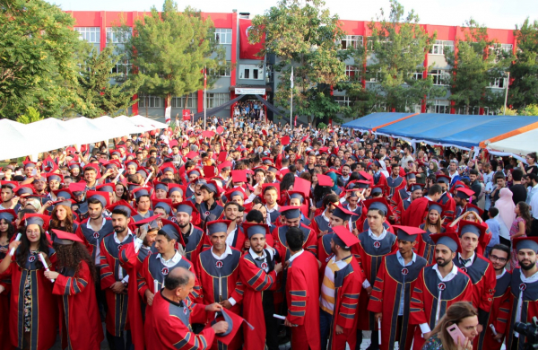

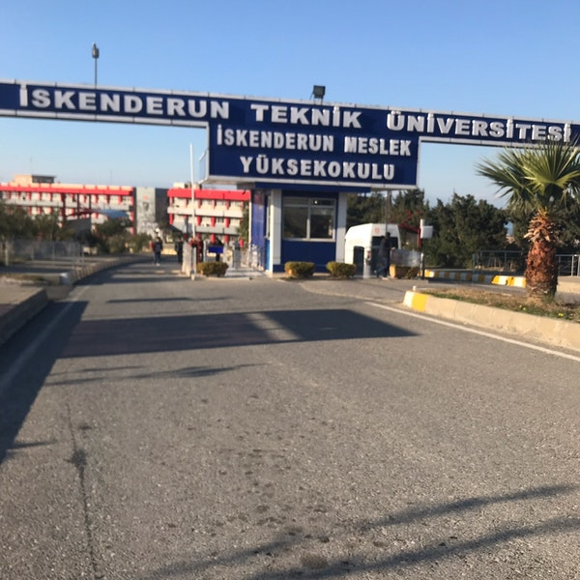

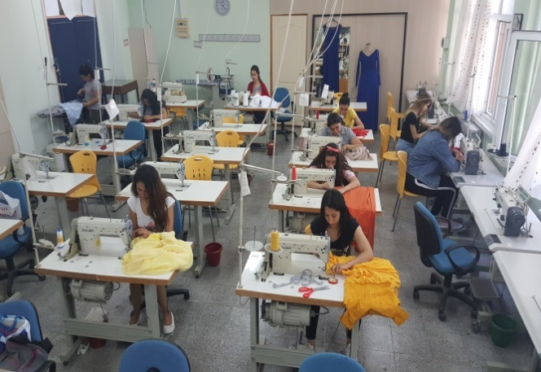
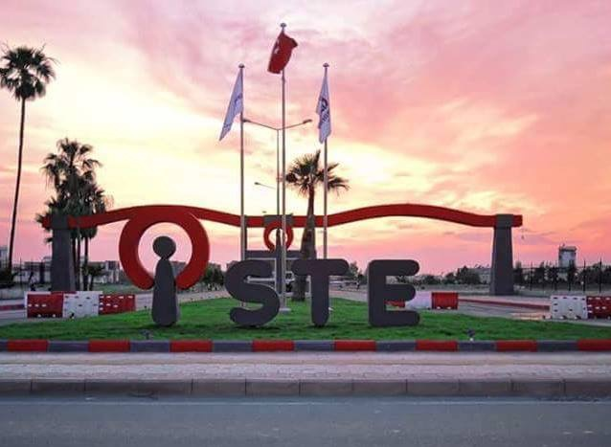
What is Clothing Production Technique?
Integration with the Business World(IBW)
Students can spend their 4th semester on business full-time to do practical work.
Throughout the IBW program, students have the opportunity to transform the theoretical knowledge they have learned into practice and have the opportunity to find a job in the institution they are in without graduating.
CLOTHING PRODUCTION TECHNOLOGY
Laboratuary Potentiality
Apparel Laboratuary (12 straight stitches, 9 computerized straight stitches, 3 overlock stitches, 1 resin stitch machine, 2 steam iron industrial type iron)
Common computer laboratories
Children's, men's and women's outer wear; pre-production planning and design, mold-pattern, quality control and production processes are indispensable humans for the textile-apparel sector.
The job of clothing production technicians; To do production work, To do work and time study, to develop clothes models, to draw clothes patterns, to control the quality of the sewing clothes, to choose the auxiliary materials and accessory tools for clothing, to prepare prototype clothes, They carry out the follow-up and control of the product from the beginning to the end of the serial production, carrying out the packing and storage of the product and marketing.
Iskenderun Technical University, Iskenderun Vocational School Textile, Clothing, Footwear and Leather Department, Clothing Production Technology Program 31200 İskenderun, HATAY/TURKEY
+90 326 618 2936- 6034
http://www.iste.edu.tr/imyo-gut

Slide 2
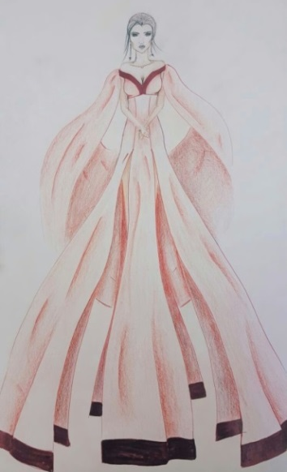
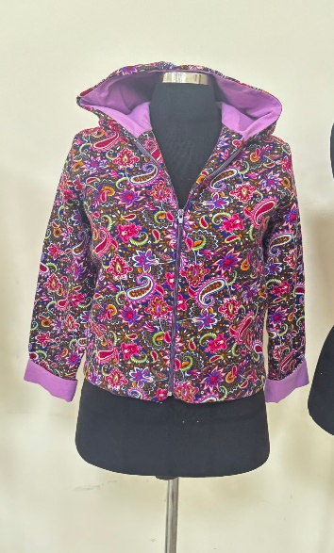
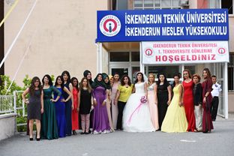
What are the Sectors for Apparel Production Technicians to Work?
Which Bachelor's Degree programs can be winned with DGS?
Ready-to-wear teacher
Fashion clothing design
Fashion design
Fashion and textile design
Textile engineering
Textile and fashion design
In the Clothing Production Technology program, basic textile training, planning of garment production, design of clothes, stylistic applications, preparation of clothes patterns, sewing of clothes, calculation of clothing costs, brand and marketing training. Clothing Production Technology Program;
Textile Technology,
Apparel Technology,
Stylistics Practices,
Dressing Technical Drawing,
Preparation of clothes patterns,
Children, Men and Women Garment Production (Sewing),
Basic Art Education
It is based on clothes decoration techniques
Textile-Apparel sector
Product development, Research development departments
Fashion designer
stylist
Master trainer in public education
As a clothing production technician in the public and private sectors
What are the Working Positions of
Apparel Production Technicians?
In textile and apparel, Product development, Research development departments
Clothing designer
Technician who is responsible for quality controlÜretim planlamadan sorumlu tekniker
Technician who is responsible for product sales and marketing
Why ISTE Clothing Manufacturing Technology?
With the growth and development of the textile sector, the need for knowledgeable and experienced technical staff to work on this area, and the possibility of finding a job after graduation.
Strong, experienced and qualified academic staff
The need for skilled and specialized garment production technicians to be employed in the public and generally private sector
The presentation of the clothes that the student designed and sewed, the ability to do the fashion show while graduating
Education in compliance with current and world standards
Close cooperation with industry thanks to Business world Integration (IBW)
Possibility of internship abroad with Erasmus program
Social and cultural activities
Education Pogram
Iskenderun Technical University is giving Associate Degree Training in Textile, Clothing, Shoes and Leather Department, Clothing Manufacturing Technology. The training curriculum is suitable for the Bologna process..

